Slide 1
IOSig: immuno-oncology signatures explorer in immunotherapy treated pan-cancer cohorts
Samuel Coleman^{1,2}, Caroline Wheeler³, Rebecca Hoyd³, Louis Denko³, Ching-Nung Lin^{1,2}, Muhammad Zaki Hidayatullah Fadlullah¹, Siwen Hu-Lieskovan¹, Christine H. Chung⁴, Ahmad A. Tarhini⁵, Daniel Spakowicz³ and Aik Choon Tan^{1,2*}, 2022 (Submitted)

Slide 2
Introduction
Immune Signature Explorer (IOSig) is a web interface that allows the user to query and explore immune checkpoint blockage treated cohorts with gene expression signatures for the purpose of predicting response to treatment.
Users can upload their own signature, expression and clinical dataset, or simply query the built-in signatures and data.
Note: Only datasets with included survival information will appear in the survival cohort drop down

Slide 3
Outline
This guide will walk through the 3 analysis methods within IOSig
Dataset Analysis
User uploads RNA-seq expression data with respective clinical data.
User Signature Analysis
User uploads a list of genes to query the built-in datasets.
Published Signature Analysis
User queries the built-in gene signatures and datasets.

Slide 4
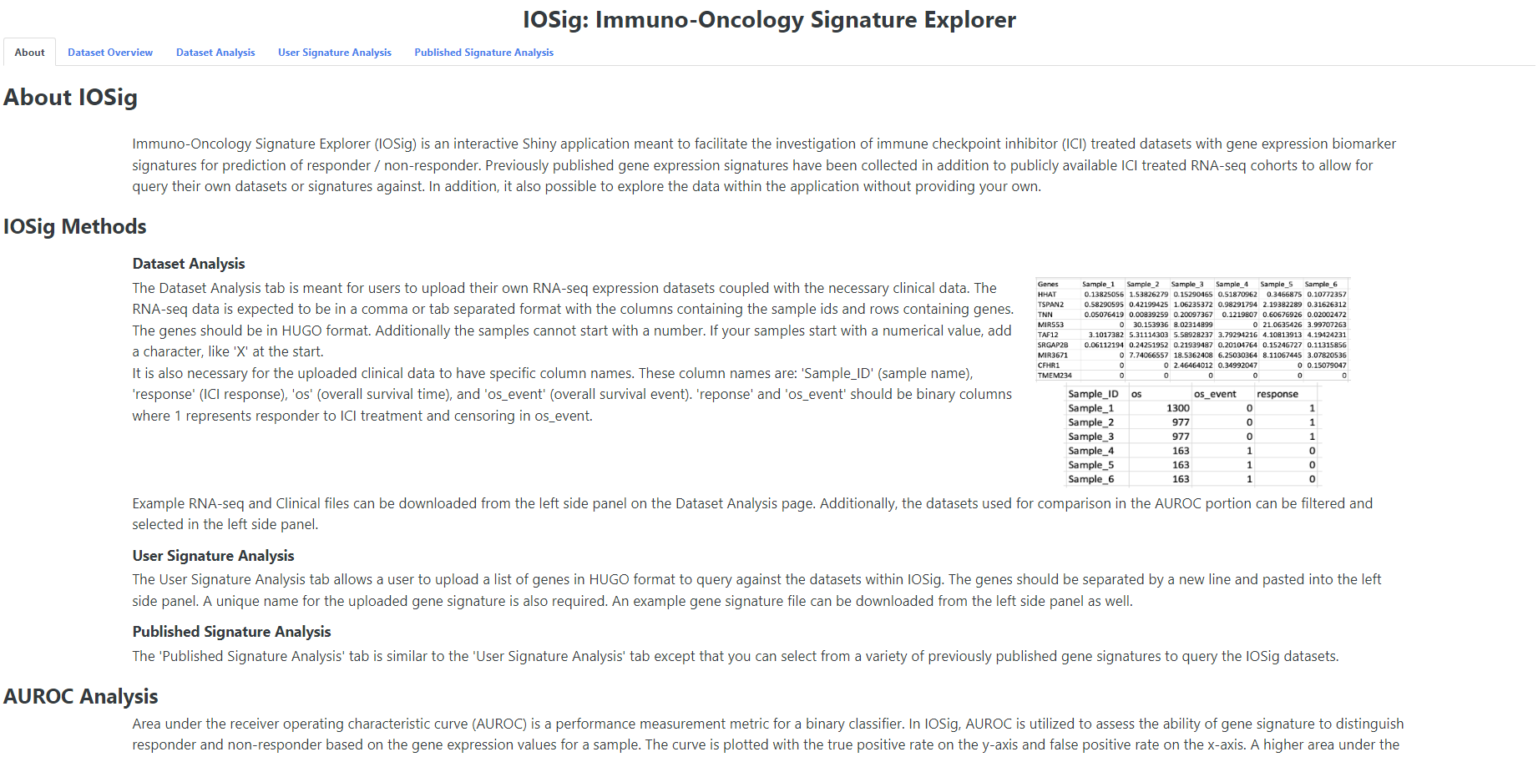
About Page
Page Selection Tabs
The About page for IOSig provides a written in-depth description of the analysis methods. These methods include Area Under Receiver Operating Characteristic Curve (AUROC), Survival analysis, Mann-Whitney U-test, and Gene Set Enrichment Analysis (GSEA).

Slide 5
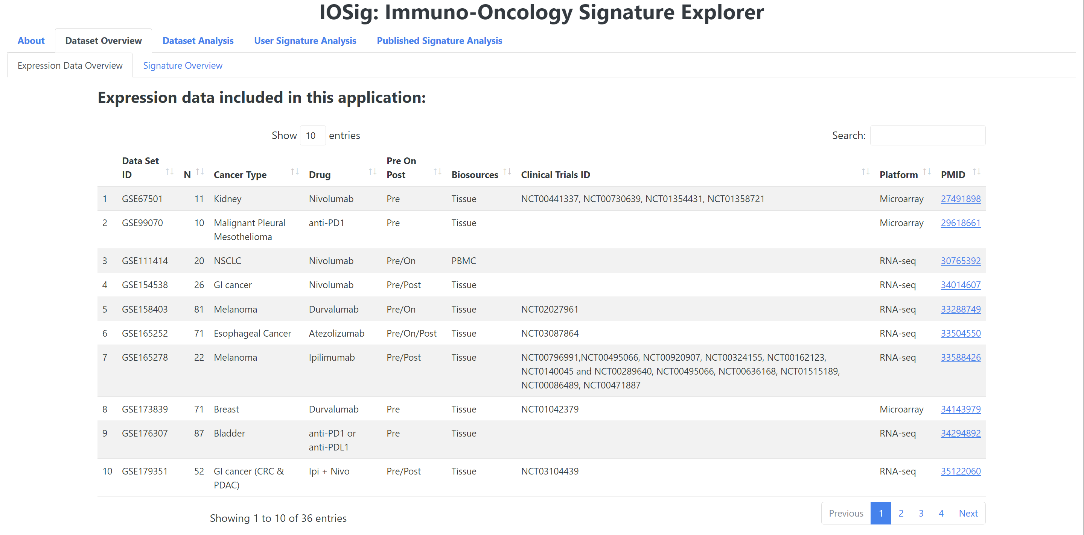
Dataset Overview
The “Expression Data Overview” tab in the “Dataset Overview” contains a table which details the datasets within IOSig
Page Selection
The expression data overview page details the sequence and clinical datasets included in IOSig. Various information including the PubMed ID, cancer type, treatment drug, is listed among other information. This table can be referenced to help users query IOSig with the datasets that best fit their interest and needs.

Slide 6
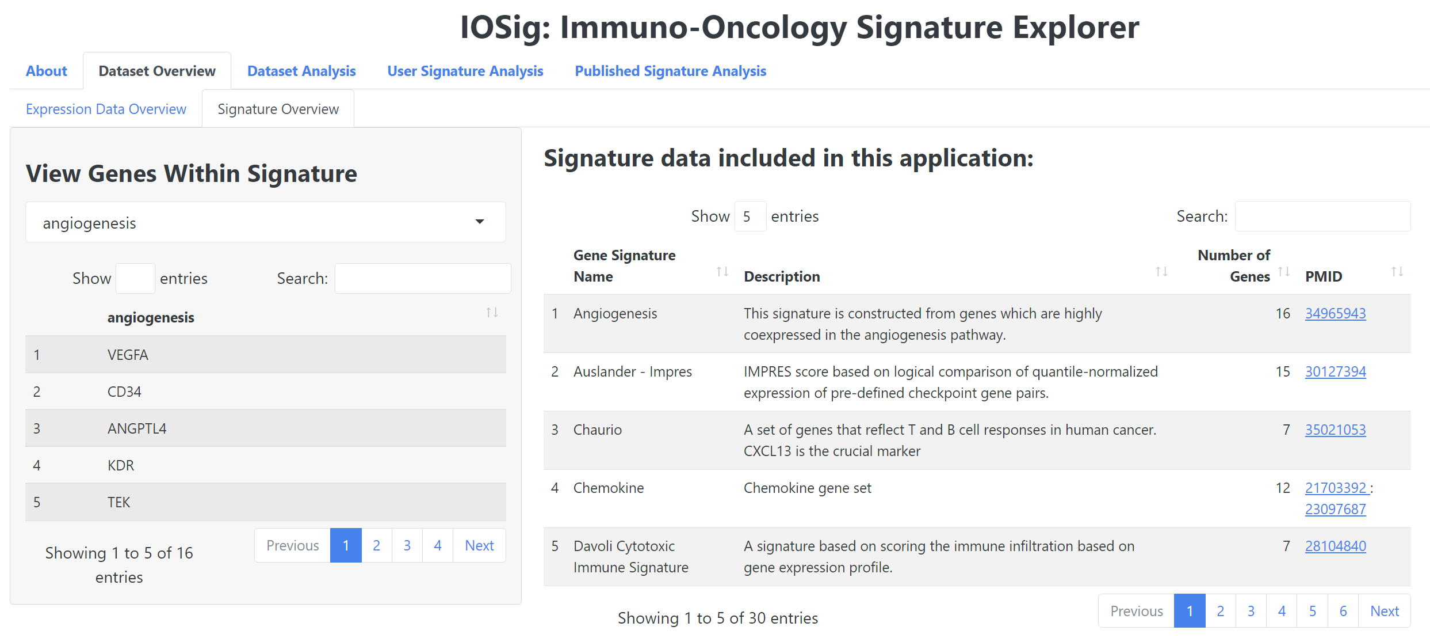
Signature Overview
Page Selection
The “Signature Overview” page details the previously published gene expression signatures included in IOSig. Various information including the PubMed ID, a brief description of the signature, and the number of genes within a signature are found in the table. Additionally, the genes within a signature can be viewed in the left panel.
View genes within a signature

Slide 7
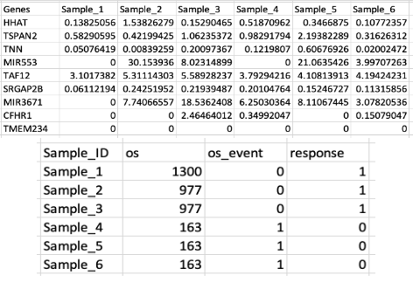
Dataset Analysis
The dataset analysis method in IOSig allows the user to import a tab or comma separated RNA-sequencing file and clinical data file.
RNA-Seq File
Prior cleaning and normalization recommended
HUGO format for genes
Column 1 must contain the genes
Sample IDs cannot begin with a number
Clinical File
4 columns required: ‘Sample_ID’, ‘response’, ‘os’, ‘os_event’
Sample IDs cannot begin with a number
Response must be 1 (responder) or 0 (non-responder)
‘os’ must be in numerical format
os_event must be 1 (event occurred) or 0 (no event occurred)

Slide 8
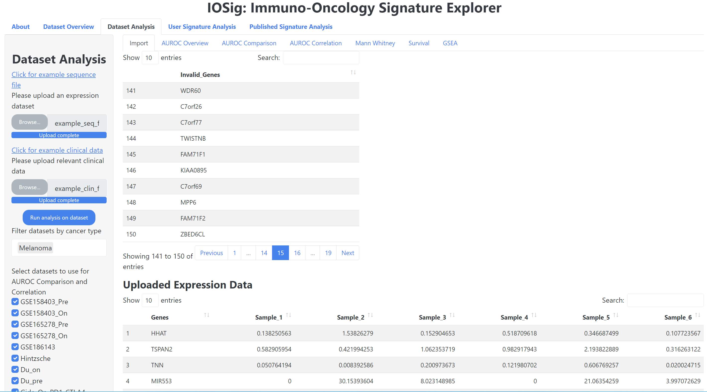
Dataset Analysis - Import
Link to download example RNA-seq file
Button to upload RNA-seq file
Link to download example clinical file
Button to upload clinical file
Table that displays invalid HUGO symbols
Button to confirm file upload and cohort selection
Optional cancer type cohort filter
RNA-seq and Clinical data, uploaded by user, is displayed below after upload confirmation
Individual cohort filter

Slide 9
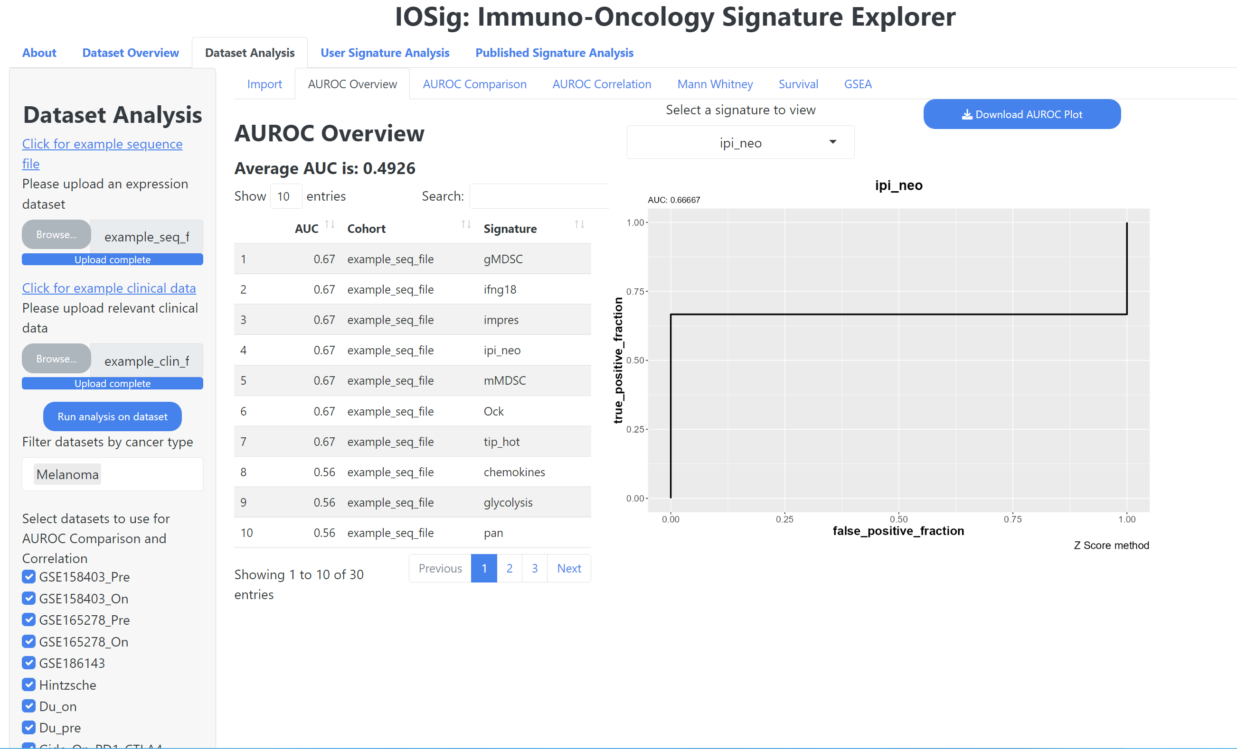
Dataset Analysis – AUROC Overview
Plot download button
Average AUC value of all signatures in IOSig on uploaded data
Select signature to view AUROC plot
Table displaying the AUC value of uploaded data against all signatures in IOSig

Slide 10
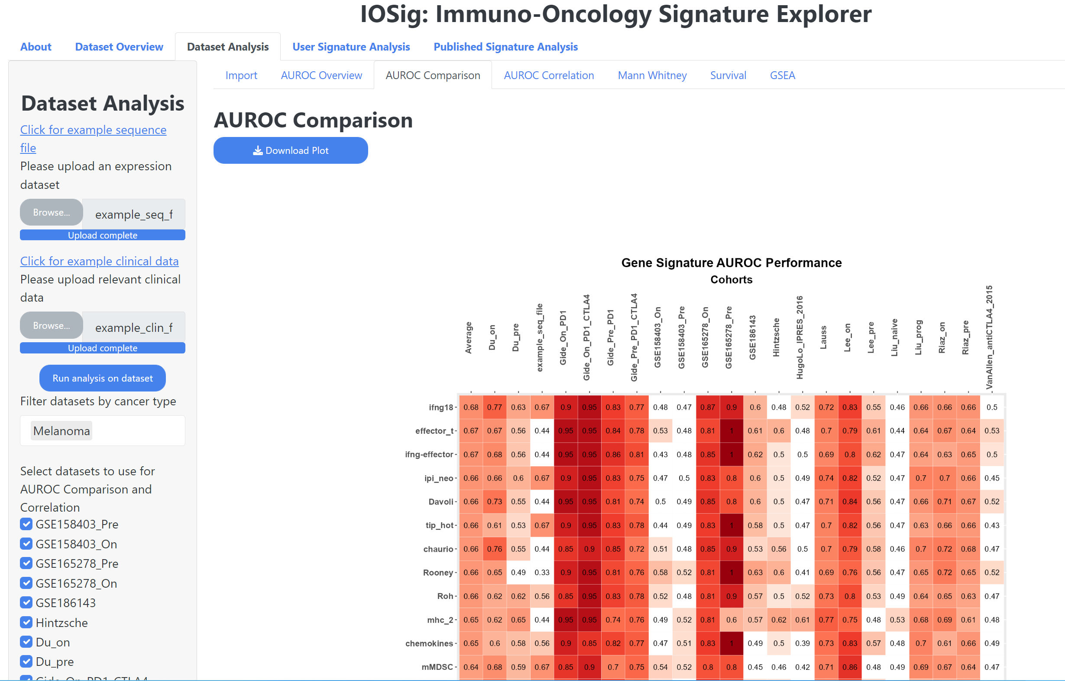
Dataset Analysis – AUROC Comparison
Download the AUROC Comparison plot
Cohorts are columns, signatures are rows

Slide 11
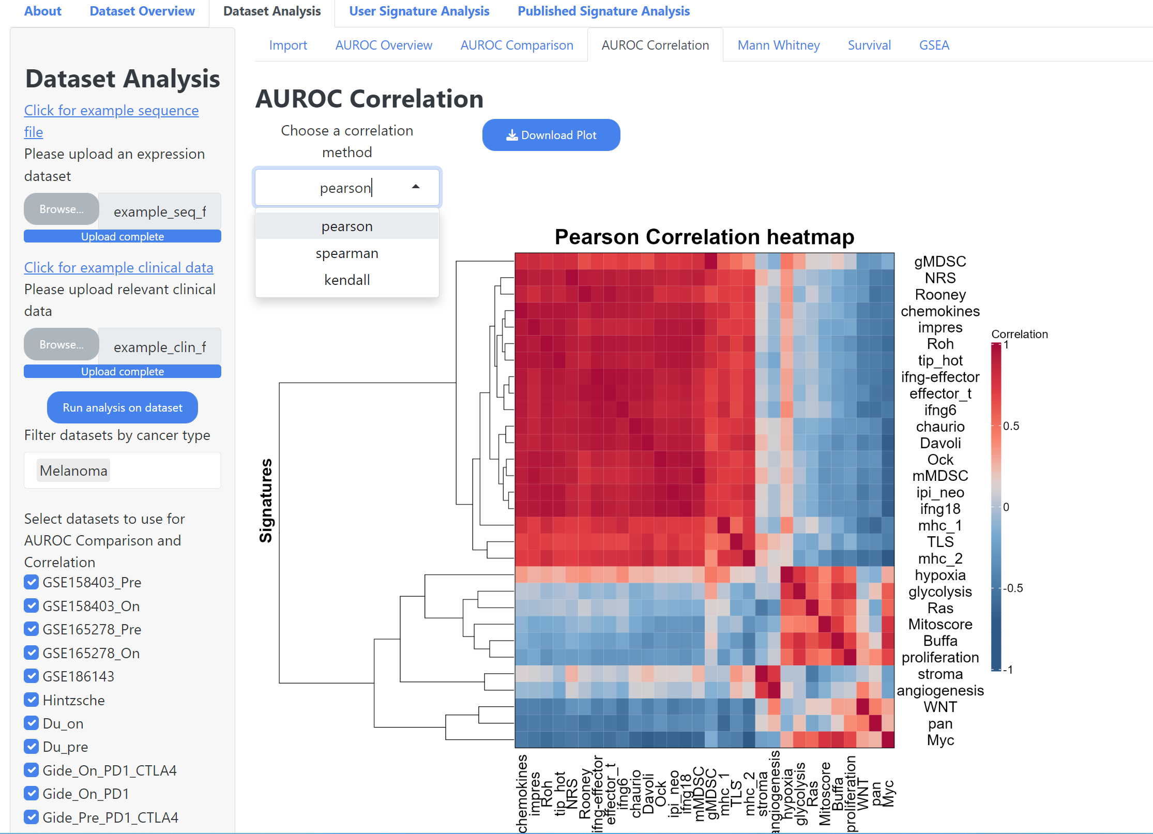
Dataset Analysis – AUROC Correlation
Download AUROC Correlation plot
Select a correlation method

Slide 12
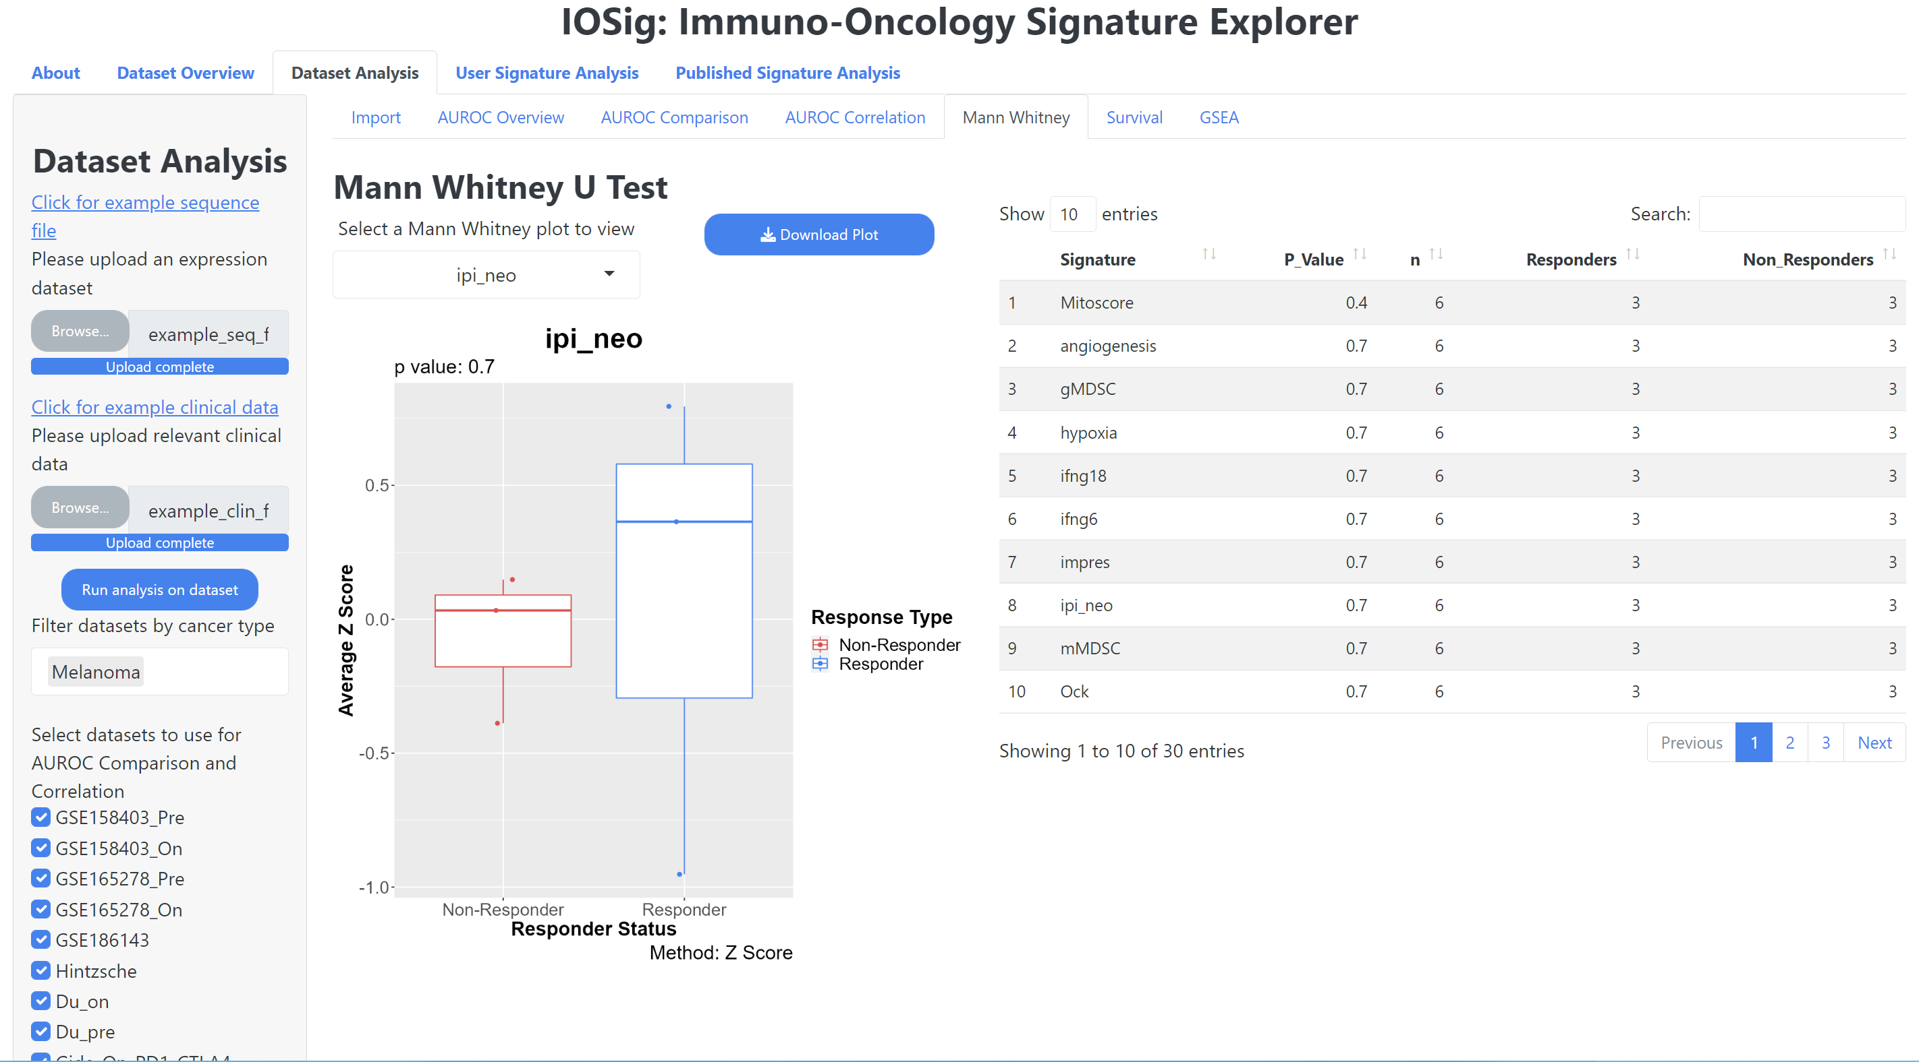
Dataset Analysis – Mann Whitney
Download Mann Whitney plot
Select a signature to view the Mann Whitney U-test boxplot
A data table showing the p-values for each signature tested against the user uploaded dataset

Slide 13
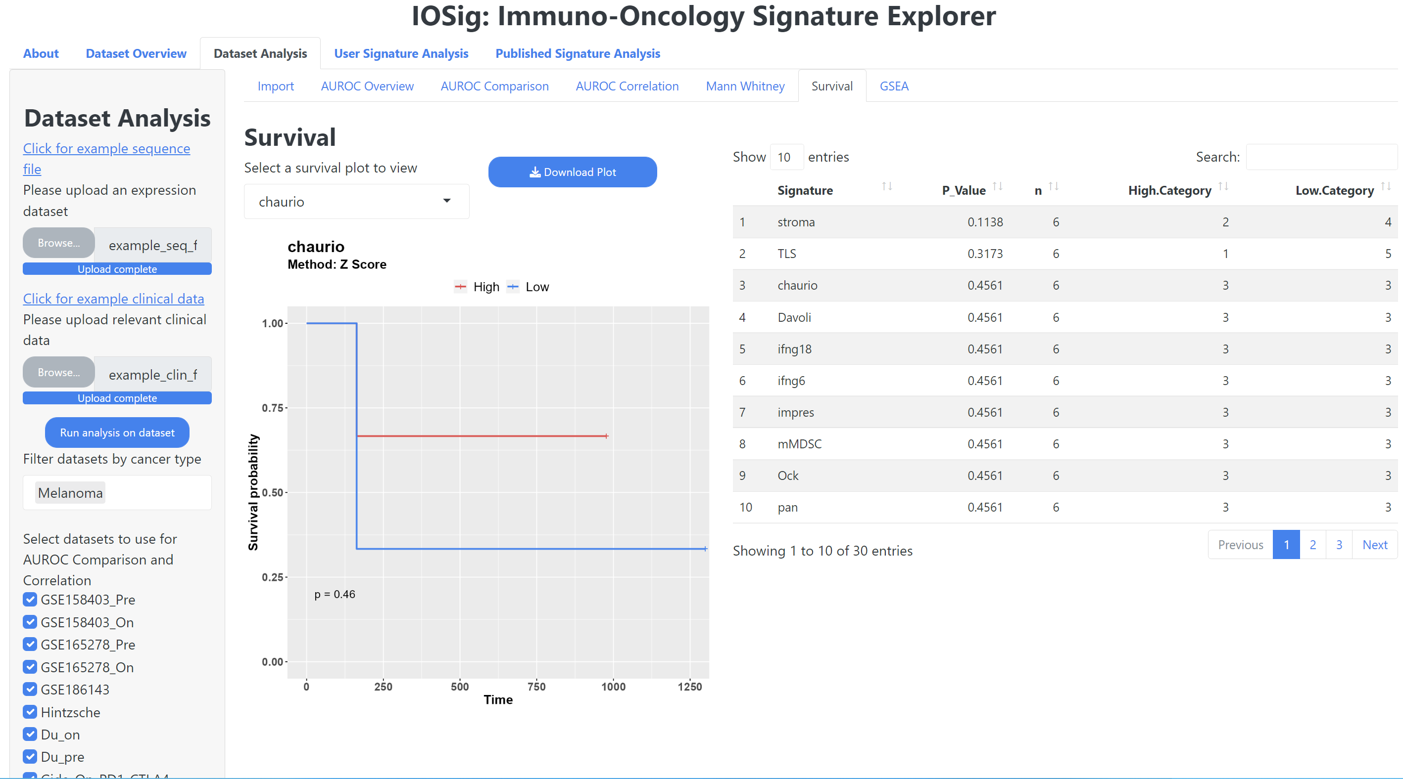
Dataset Analysis – Survival
Download the survival plot
Select a signature to view the survival plot for
A table that displays the p-value for the signatures queried against the upload data

Slide 14
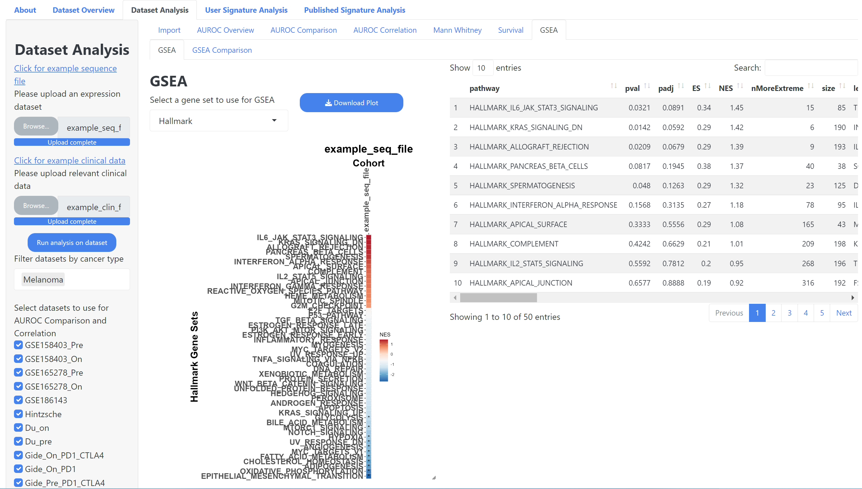
Dataset Analysis - GSEA
Download GSEA plot
Select a gene set to use
The result table for the gene set enrichment analysis

Slide 15
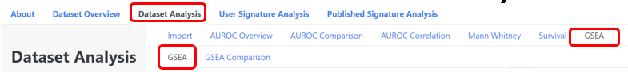
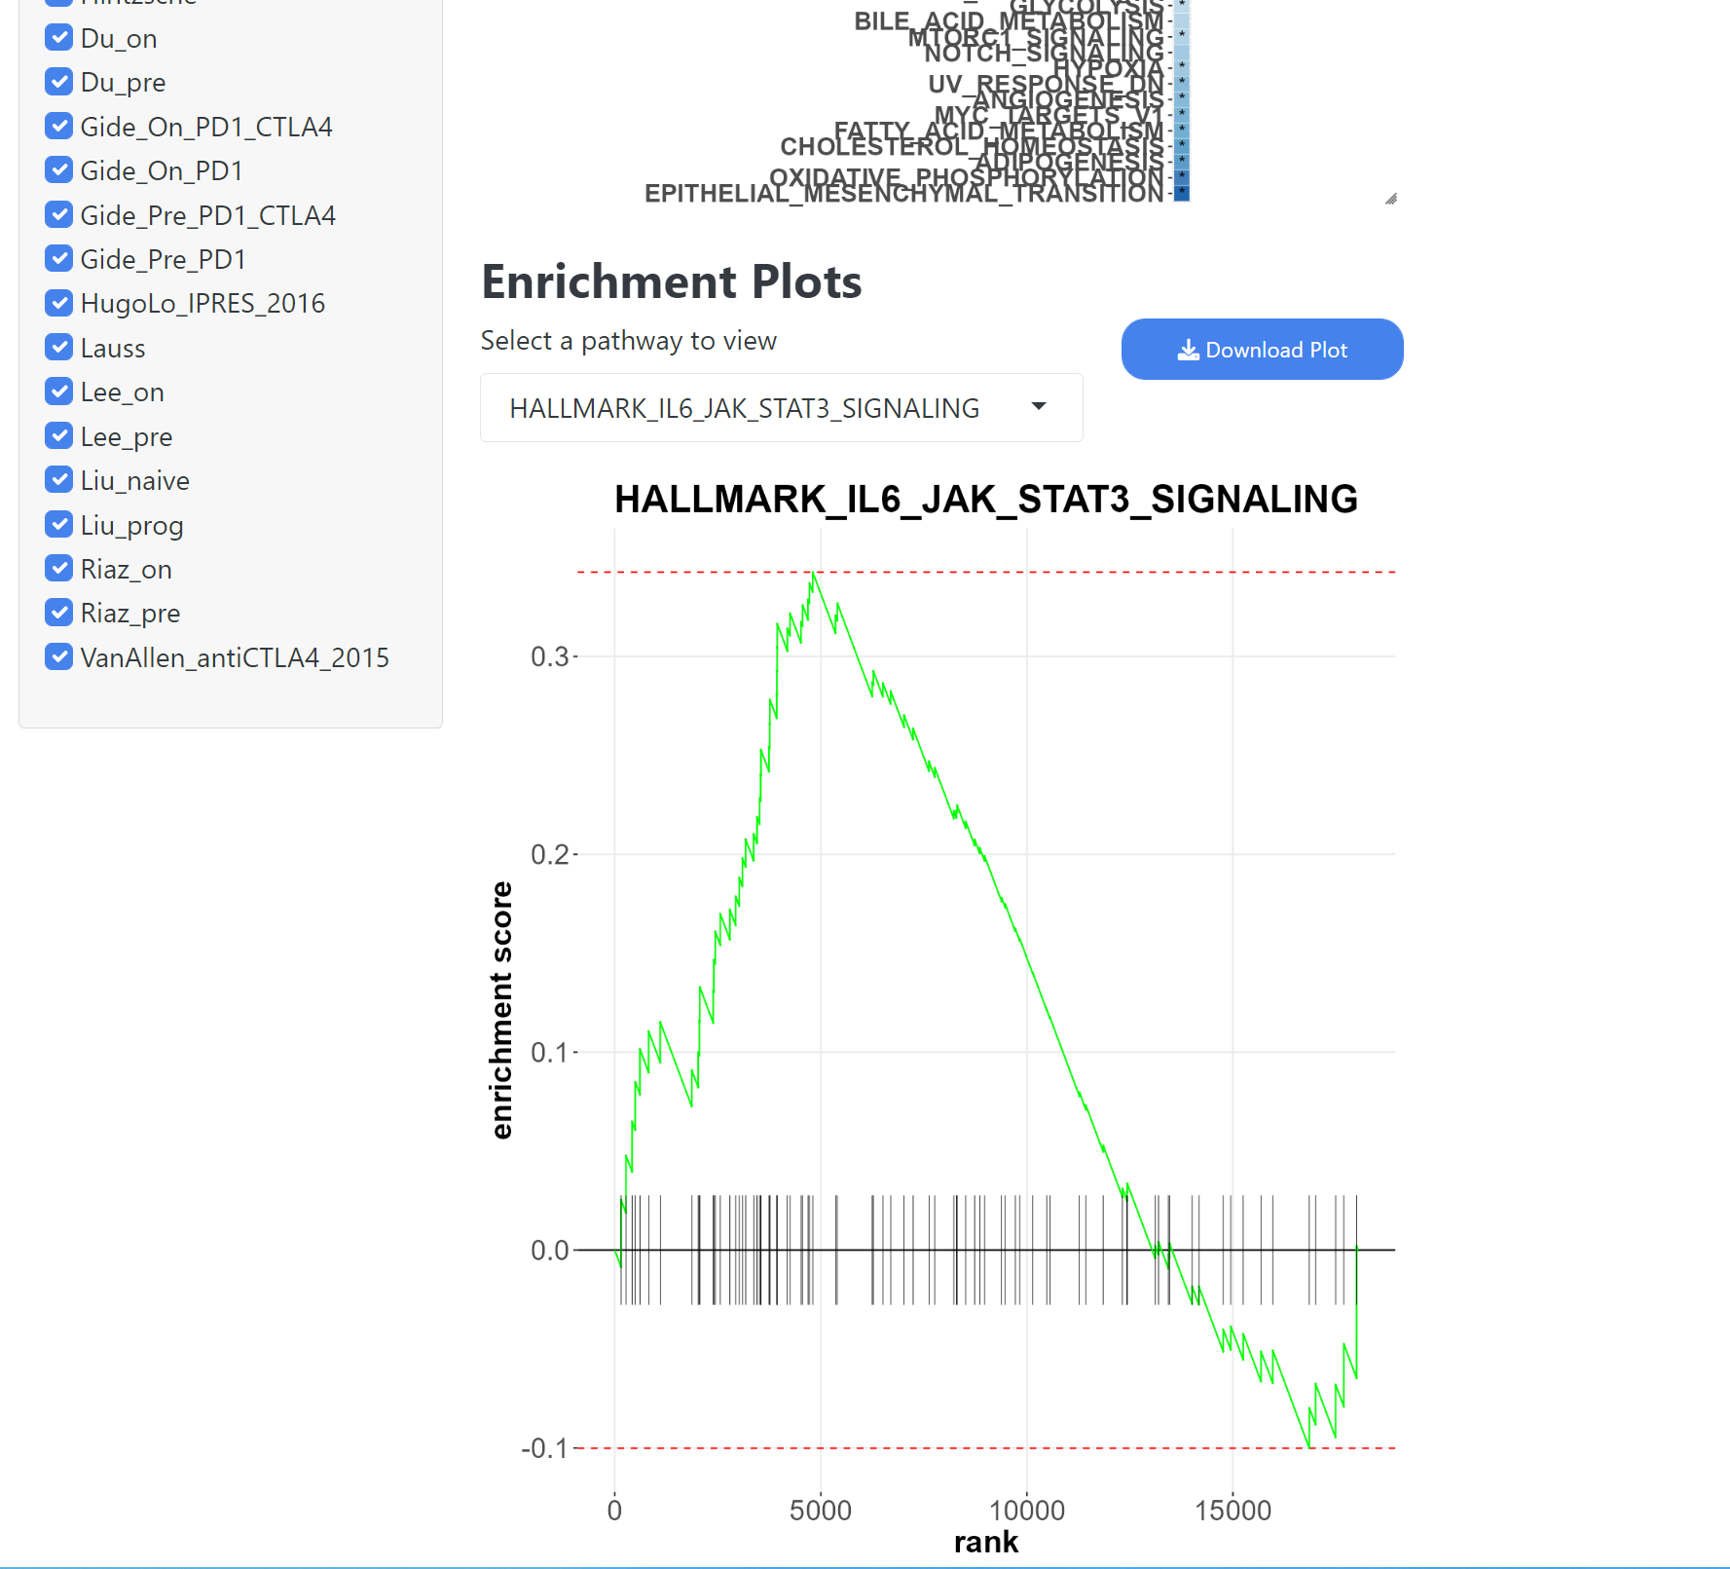
Dataset Analysis– GSEA Enrichment
Scroll down on the page to view the specific enrichment plot output
Download the enrichment pathway plot
Select an enrichment pathway to view

Slide 16
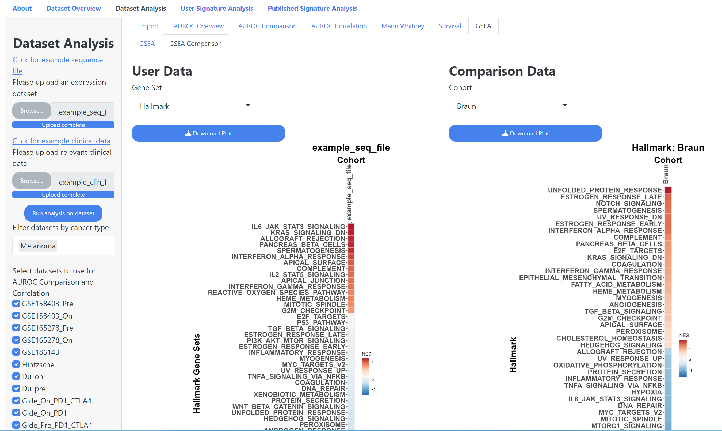
Dataset Analysis – GSEA Comparison
Select a gene set for the comparison
Select a cohort for the comparison
Download the user plot
Download the Comparison plot

Slide 17
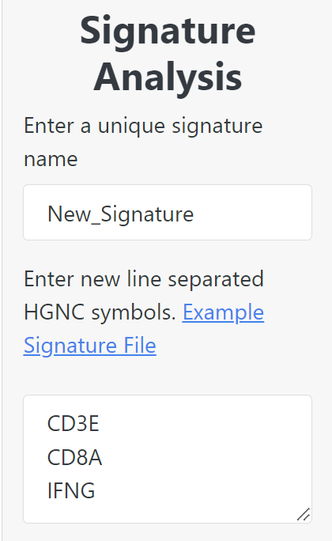
User Signature Analysis
The User Signature Analysis method in IOSig allows the user to upload a newline separated list of HUGO formatted genes and query their ability to predict responder / non-responder in the datasets included in IOSig.
Users must provide a name for their signature that does match with one of the signatures already included in IOSig.

Slide 18
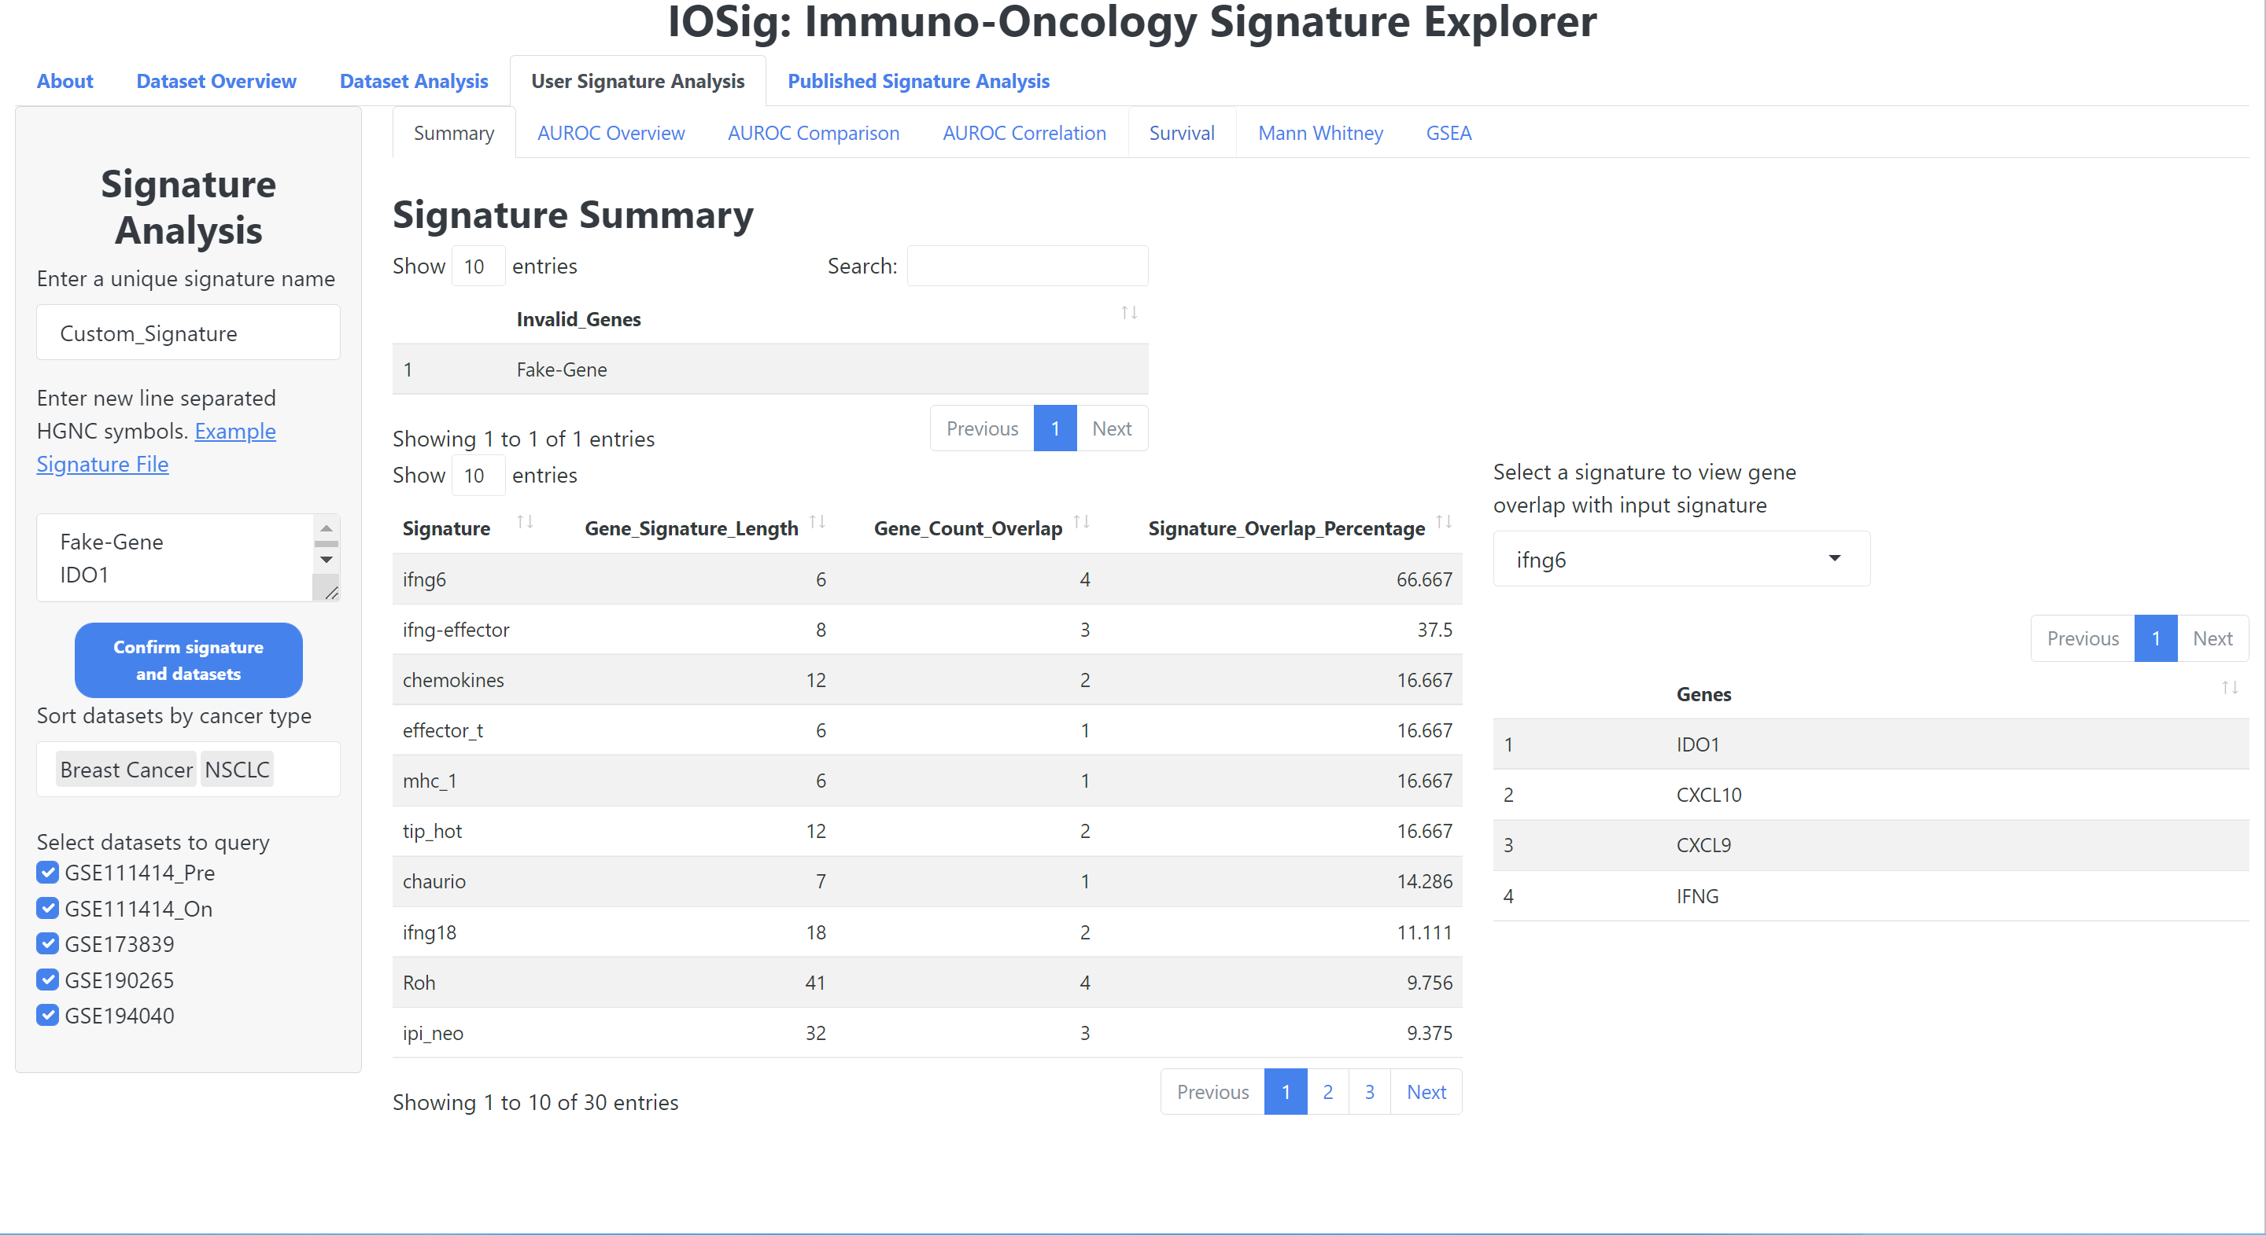
User Signature Analysis - Summary
Signature Name
Genes not detected as valid HUGO symbols
Select a signature to view gene overlap with user uploaded signature
Download example signature file
Paste newline separated HUGO genes
Confirm gene signature upload and cohort selection
Optionally filter datasets by cancer type
Select individual cohorts to include / remove
View overlapping genes between user uploaded signature and signatures included in IOSig
Gene overlap statistics between user uploaded signature and signatures included in IOSig

Slide 19
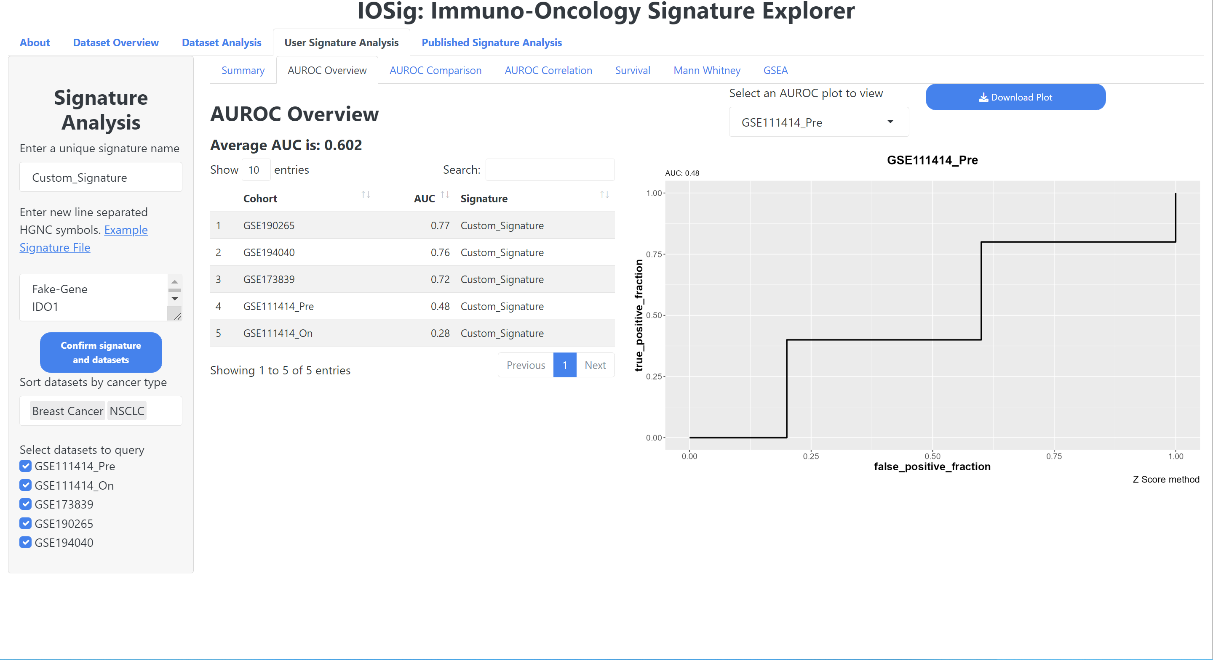
User Signature Analysis – AUROC Overview
c
Select a cohort plot to view
c
Download AUROC plot
The average AUC value of the signature across all selected cohorts
A table showing the user signature AUC values in each cohort selected

Slide 20
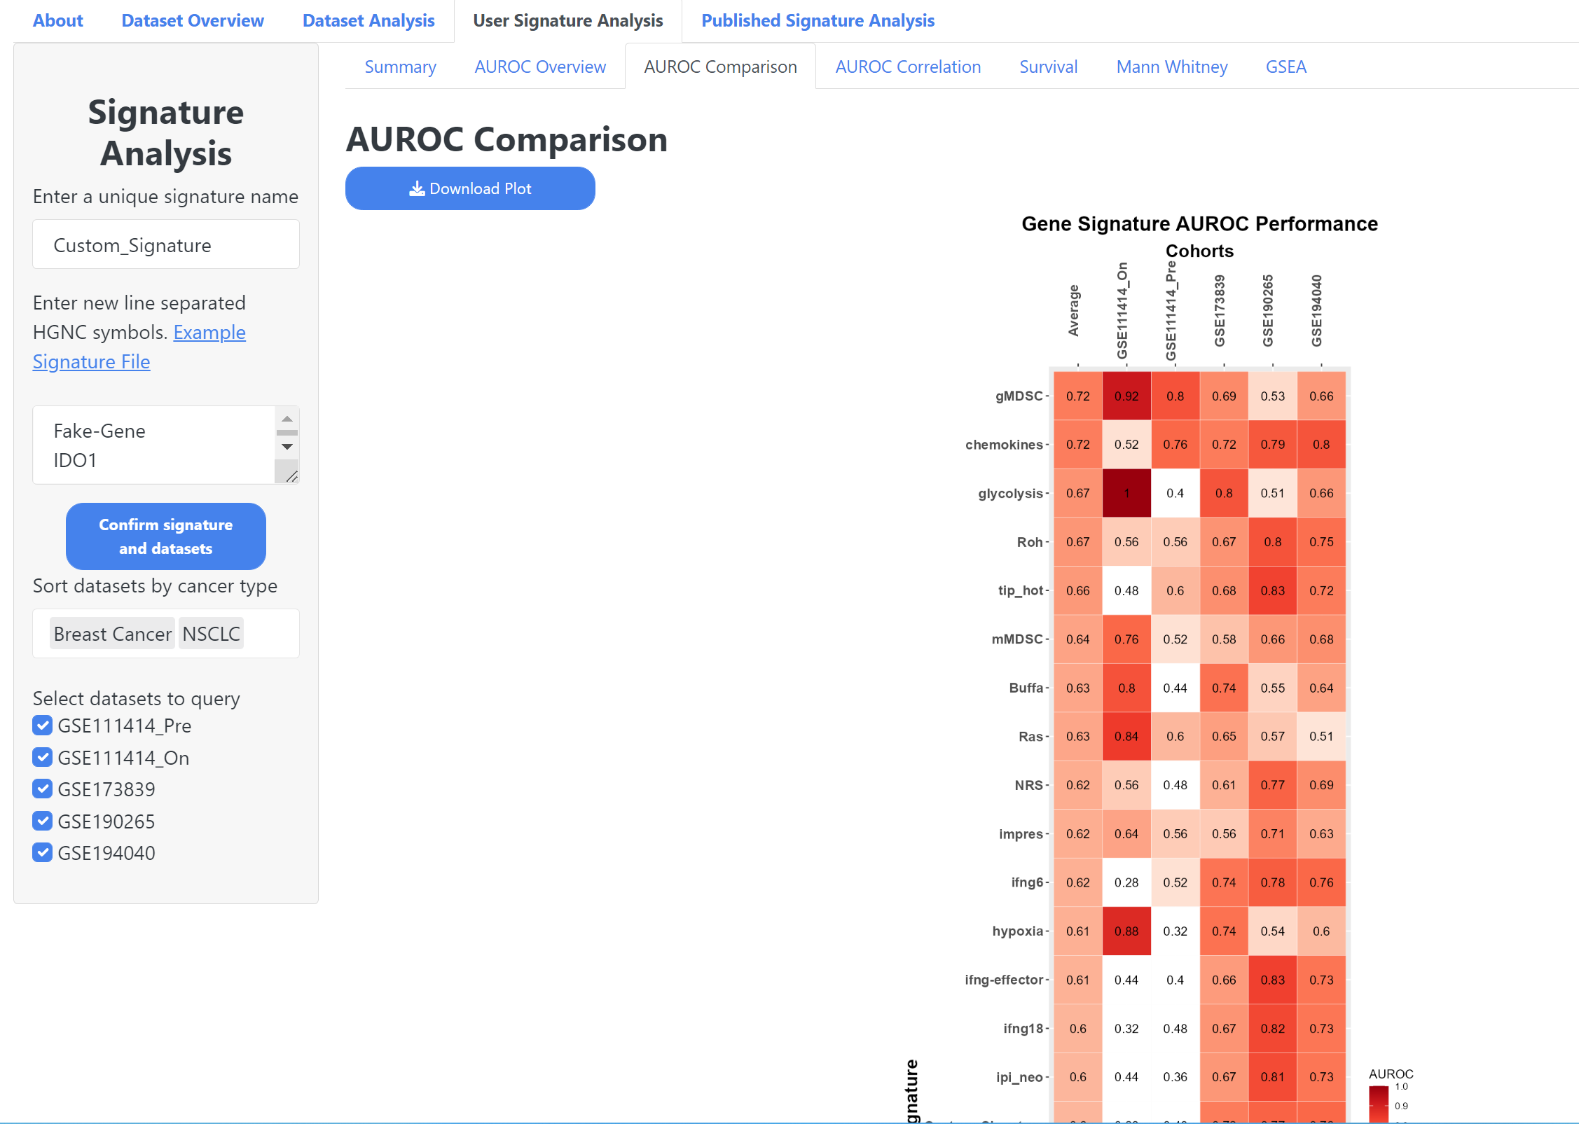
User Signature Analysis – AUROC Comparison
Download AUROC Plot
Gene signatures are in rows cohorts are columns

Slide 21
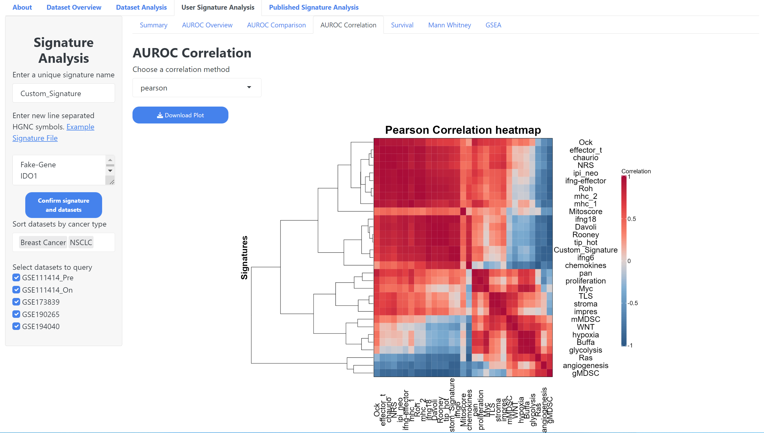
User Signature Analysis – AUROC Correlation
Choose a correlation method
Download Correlation Plot

Slide 22
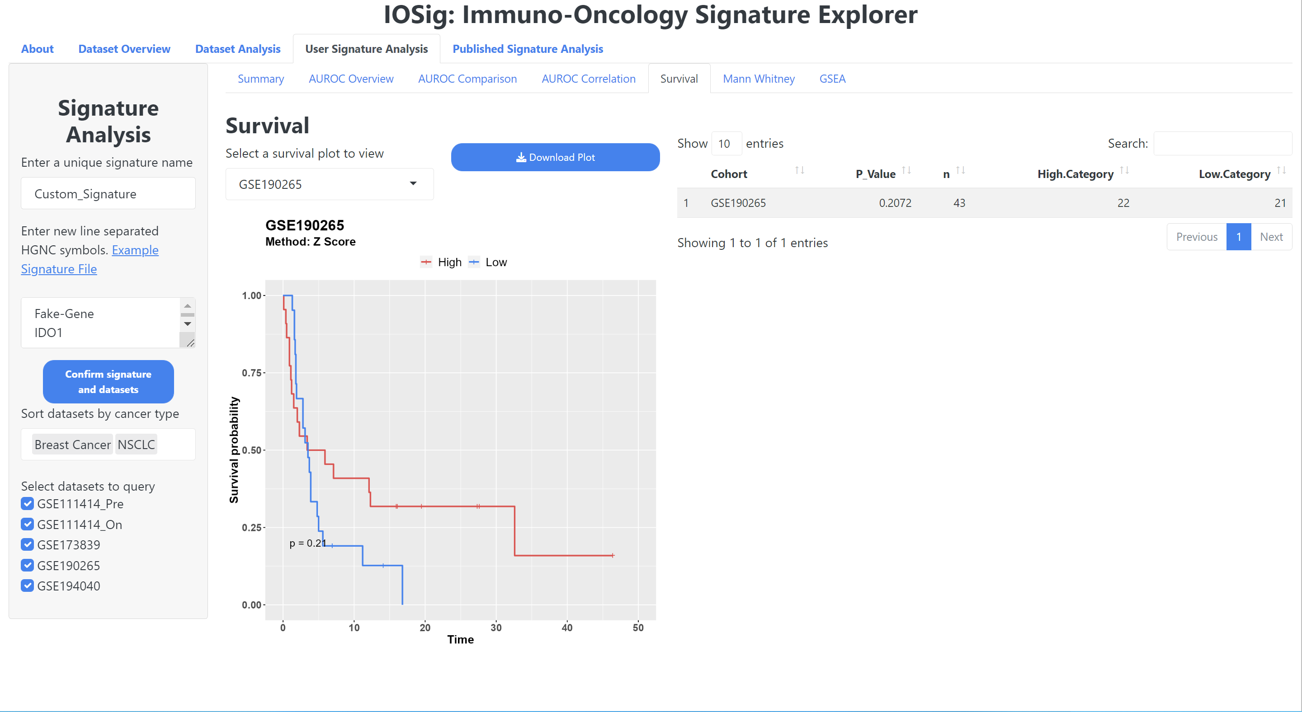
User Signature Analysis - Survival
Download survival plot
Select a survival plot to view
A table that shows the p-value and other stats for the cohort survival analysis with the user signature

Slide 23
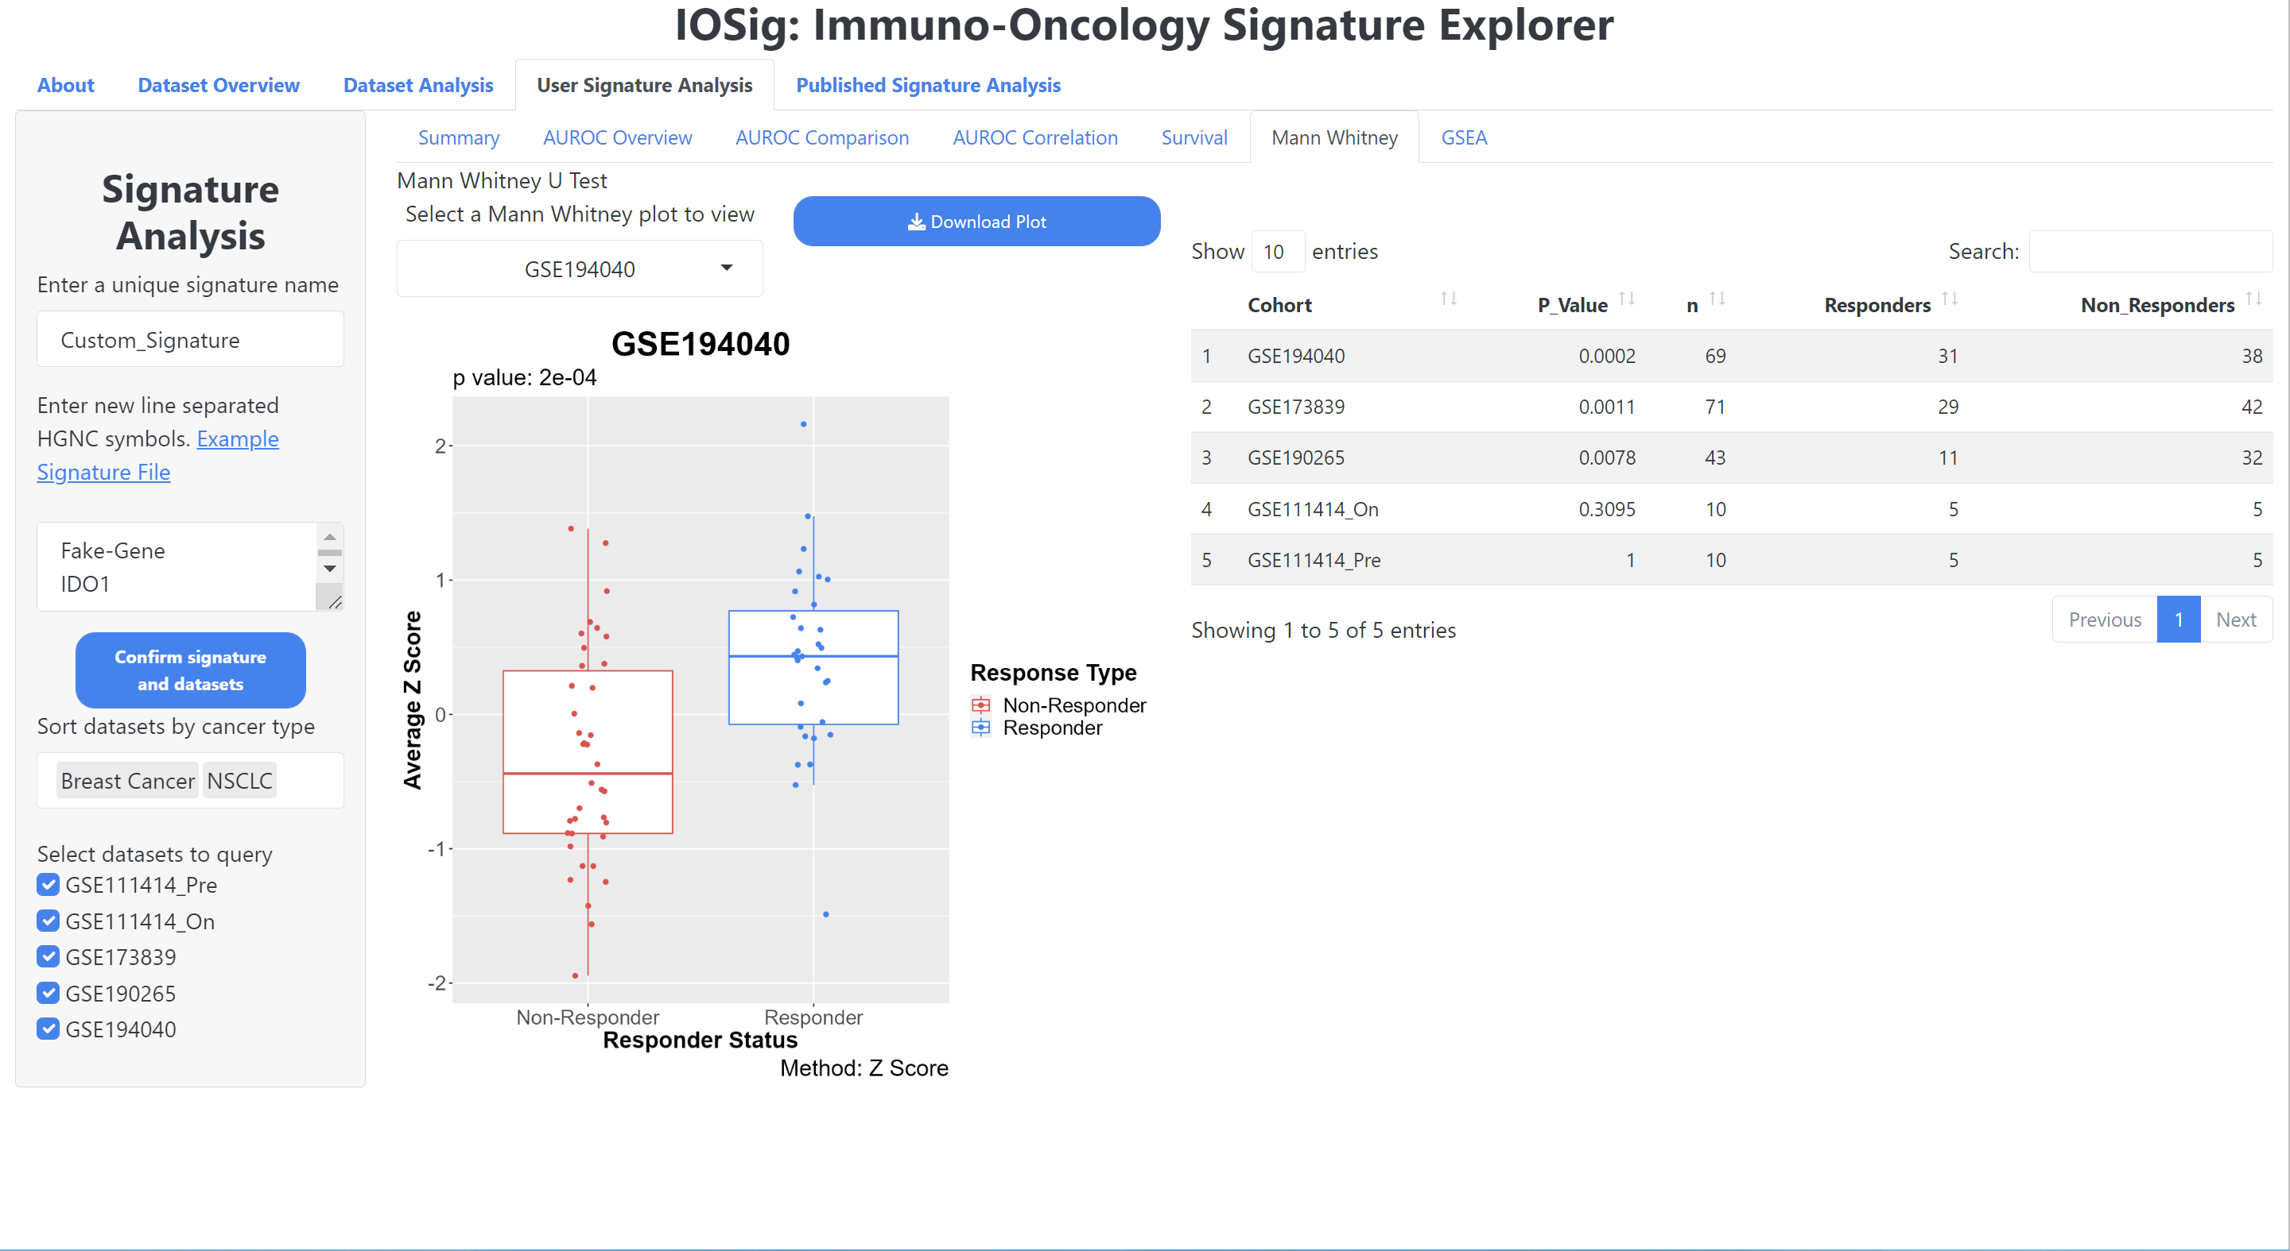
User Signature Analysis – Mann Whitney
Download Boxplot
Select Boxplot to view
View p-value and other statistics

Slide 24
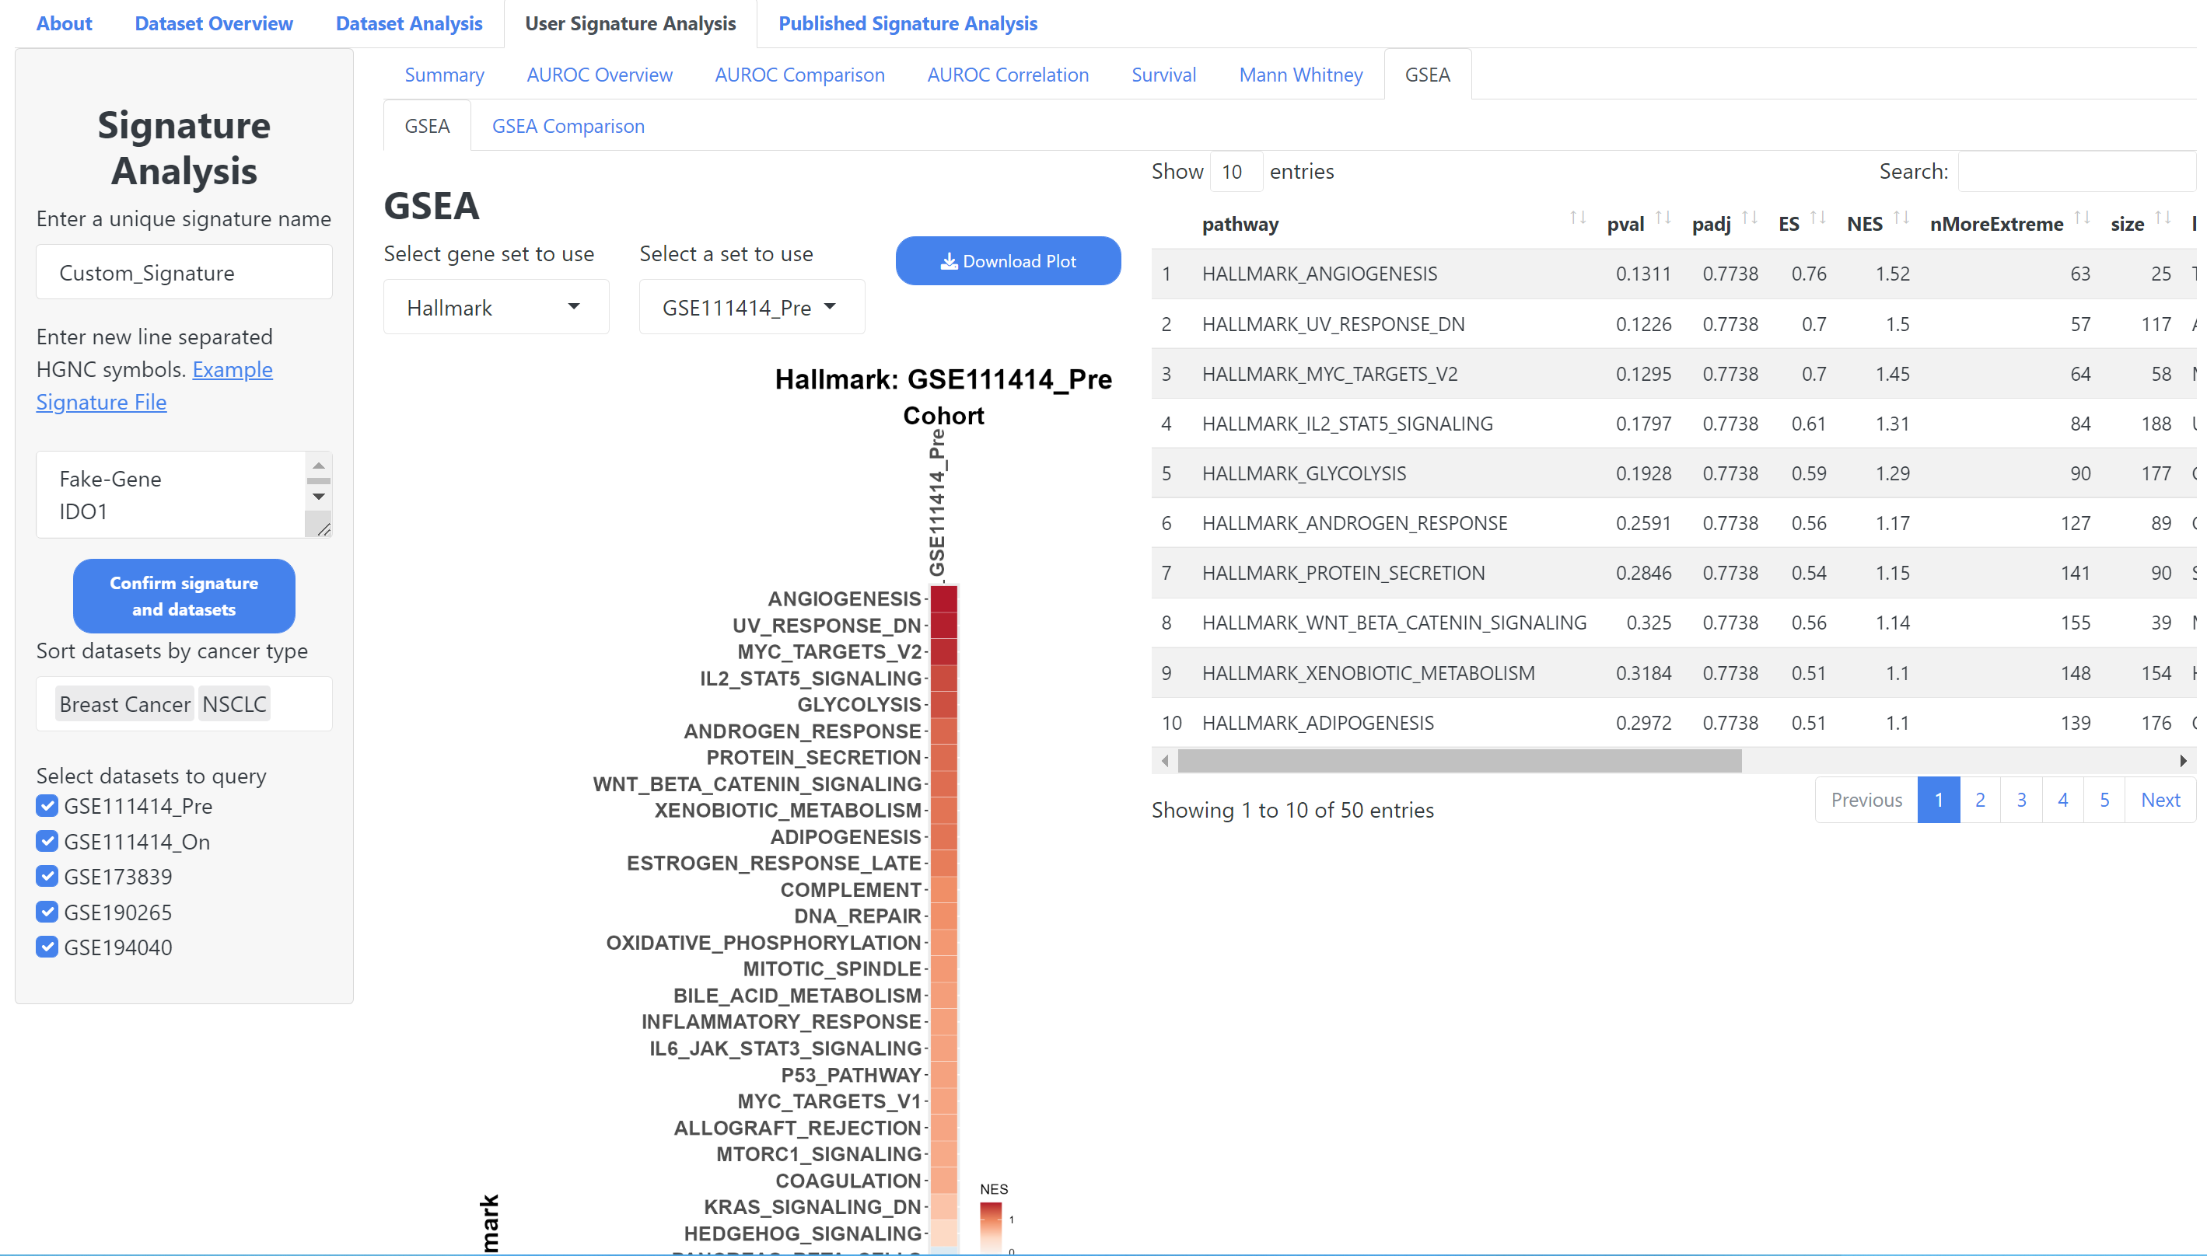
User Signature Analysis - GSEA
Select a cohort to view
Download Plot
Select a gene set to use
Resulting gene set enrichment data table

Slide 25
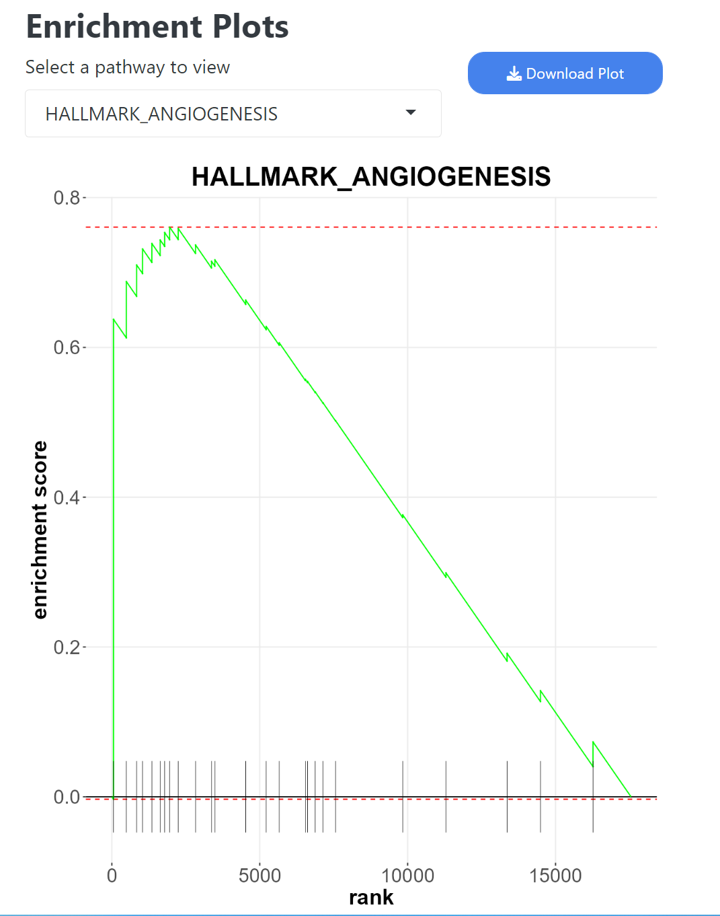
User Signature Analysis – GSEA Enrichment
Scroll down on the User Signature GSEA page
Download the enrichment plot
Select an enrichment pathway to view

Slide 26
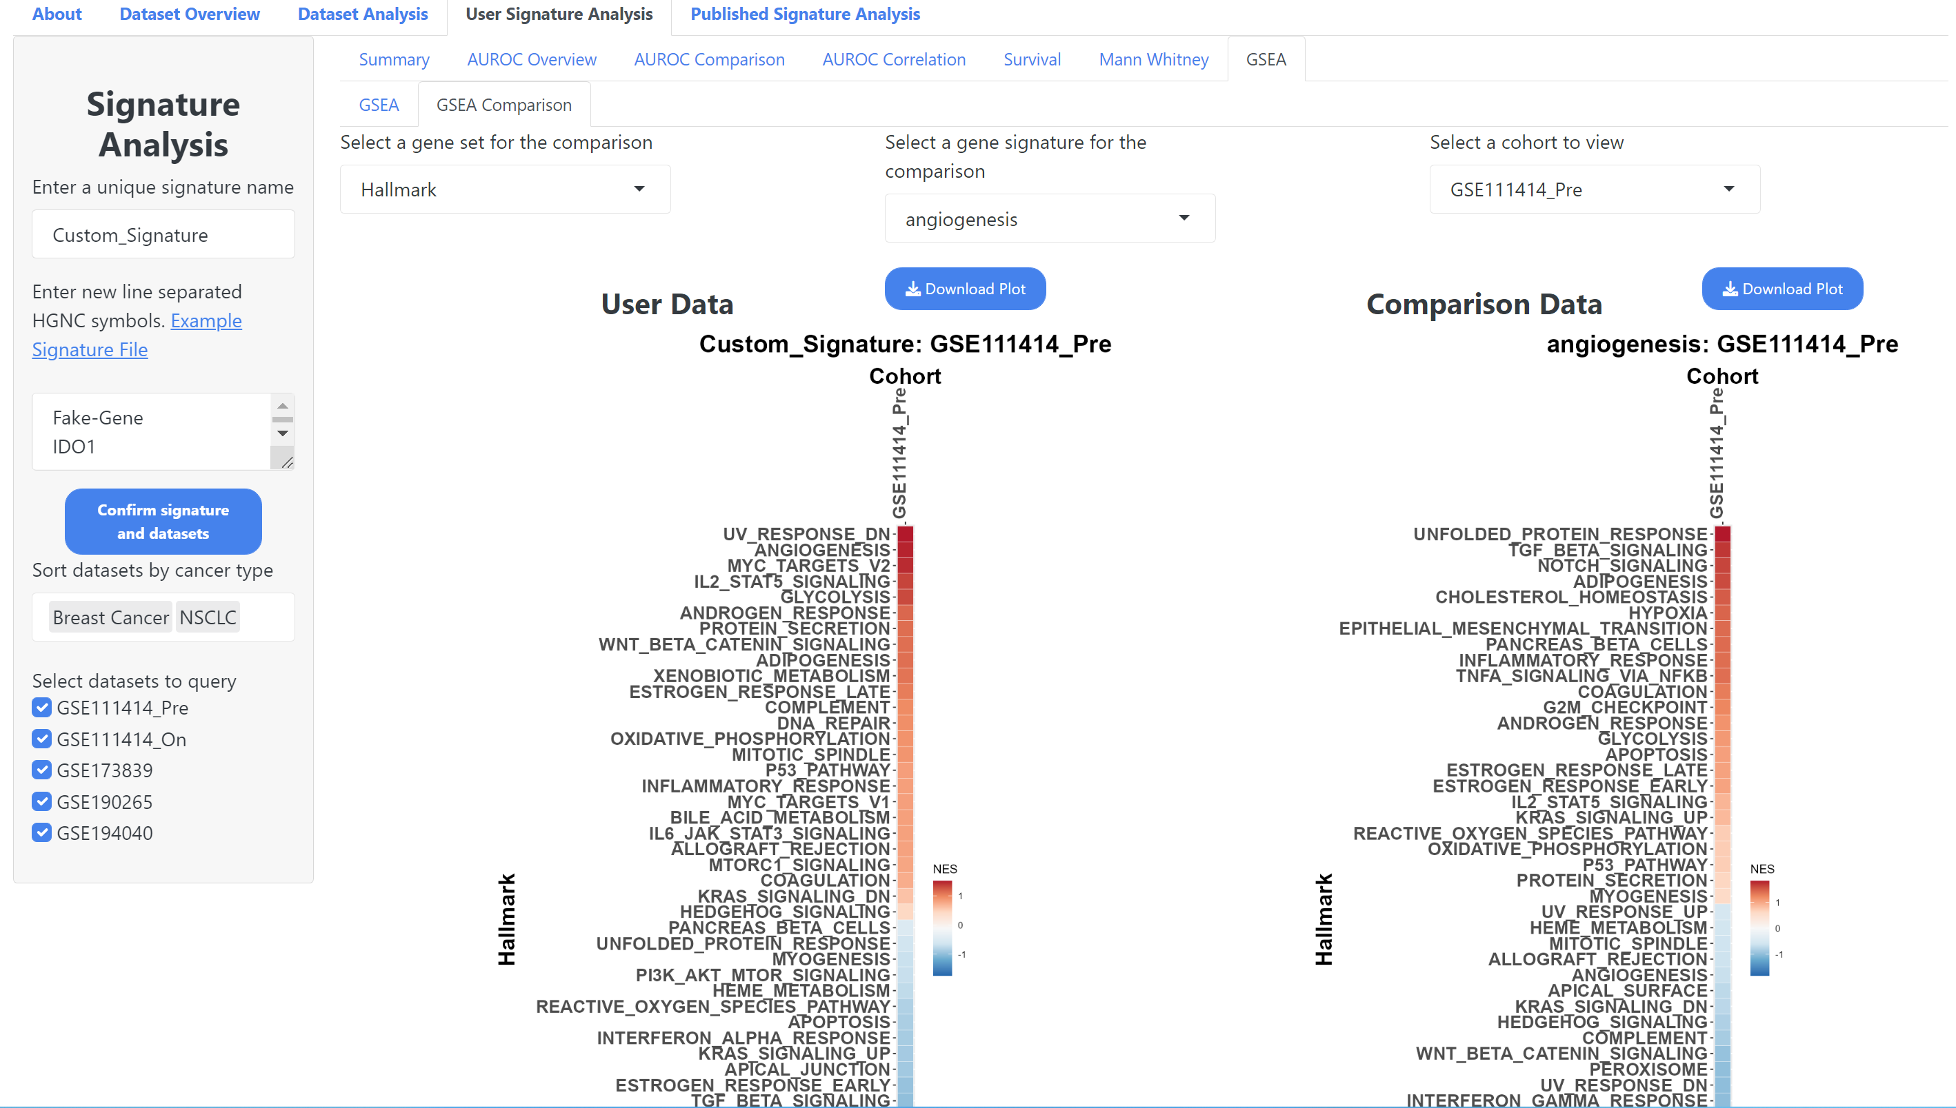
User Signature Analysis – GSEA Comparison
Select a cohort to use for the comparison
Select a gene set for the comparison
Select a signature to compare user signature against

Slide 27
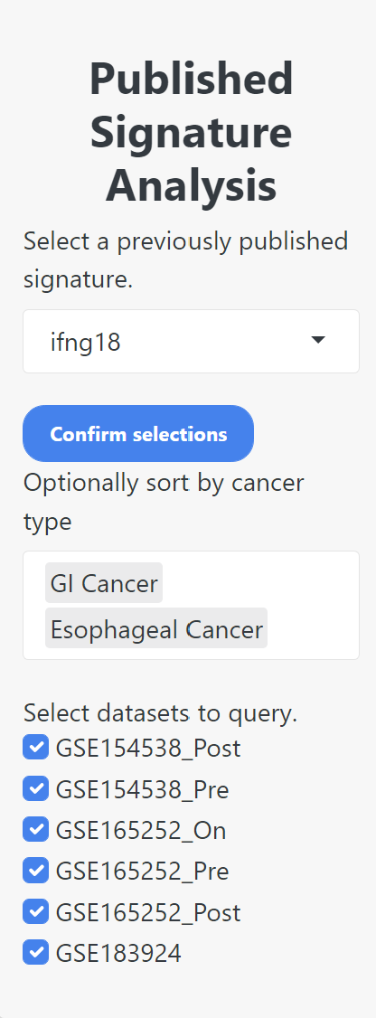
Previously Published Signature Analysis
The previously published signature analysis method if for users who want to query the data built into IOSig. IOSig contains RNA-seq, with accompanying clinical data, with previously published gene expression signatures.
This method allows users to explore the data without needing to provide any of their own.

Slide 28
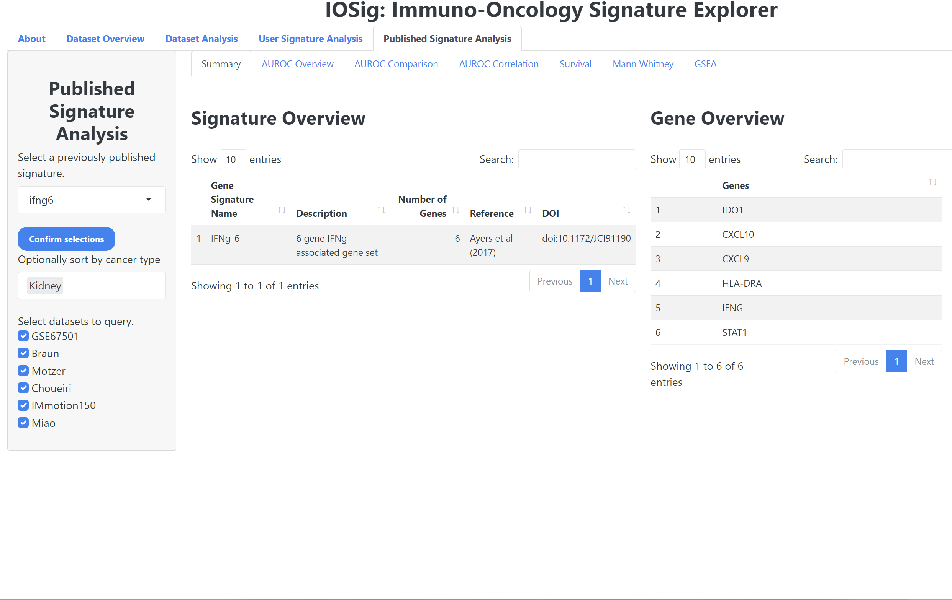
Previously Published Signature - Summary
Select a signature to view
Confirm signature and dataset selections
A table of the genes within the selected signature
Optionally filter datasets by cancer type
Select individual datasets to use for the analysis
A table that displays various data points about the selected signature

Slide 29
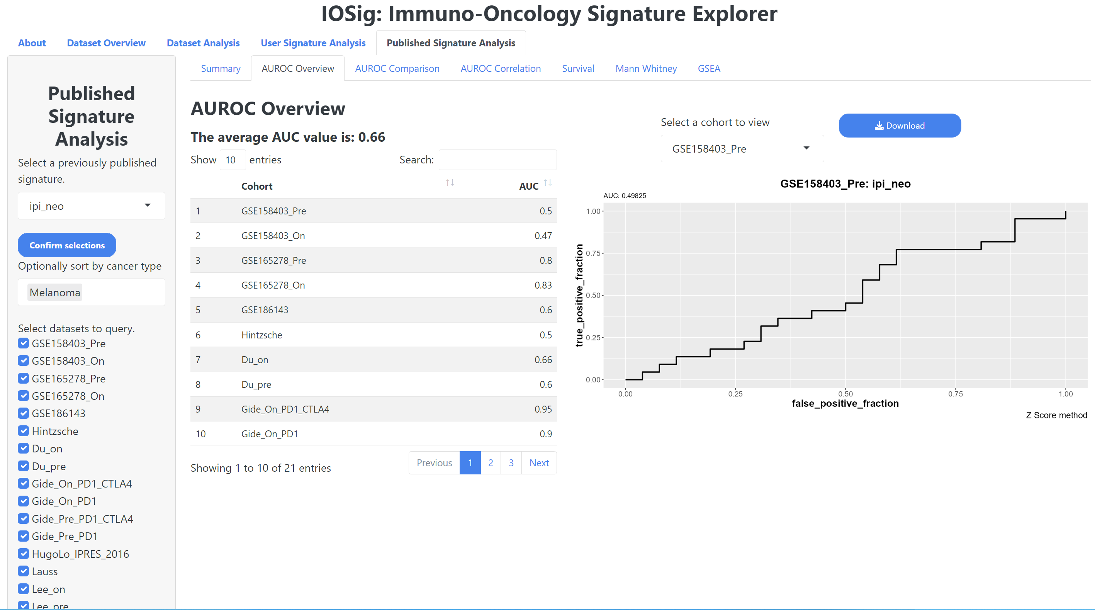
Previously Published Signature – AUROC Overview
Download the AUROC plot
Average AUC value of the signature across all cohorts
Select and AUROC to view
Table displaying the AUC values in each cohort

Slide 30
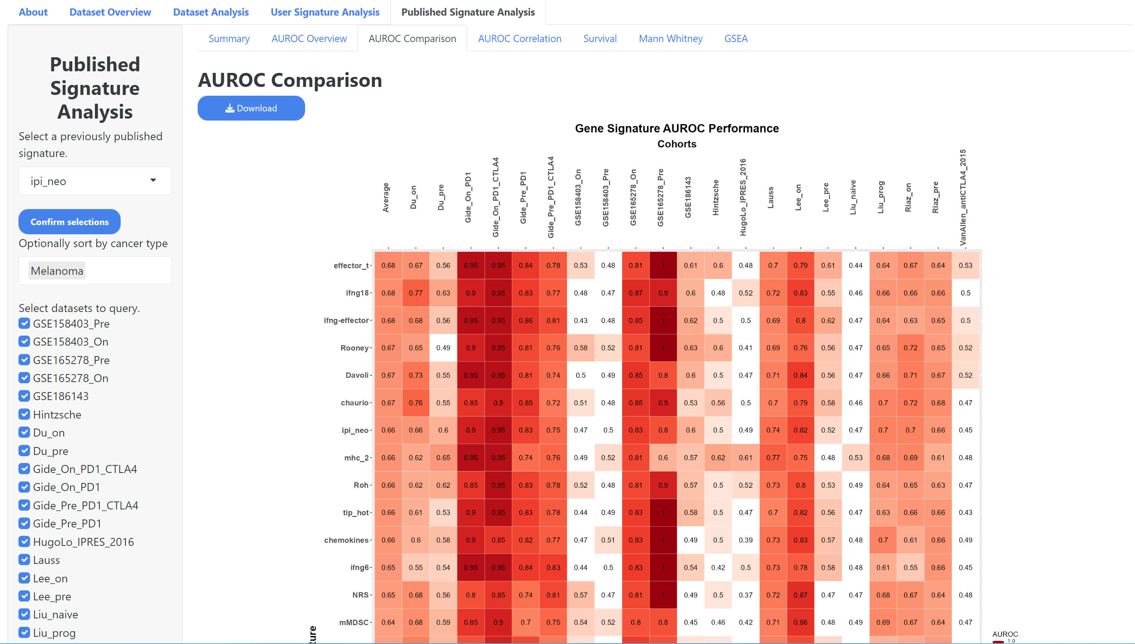
Previously Published Signature – AUROC Comparison
Rows are signatures and columns are cohorts
Download AUROC comparison plot

Slide 31
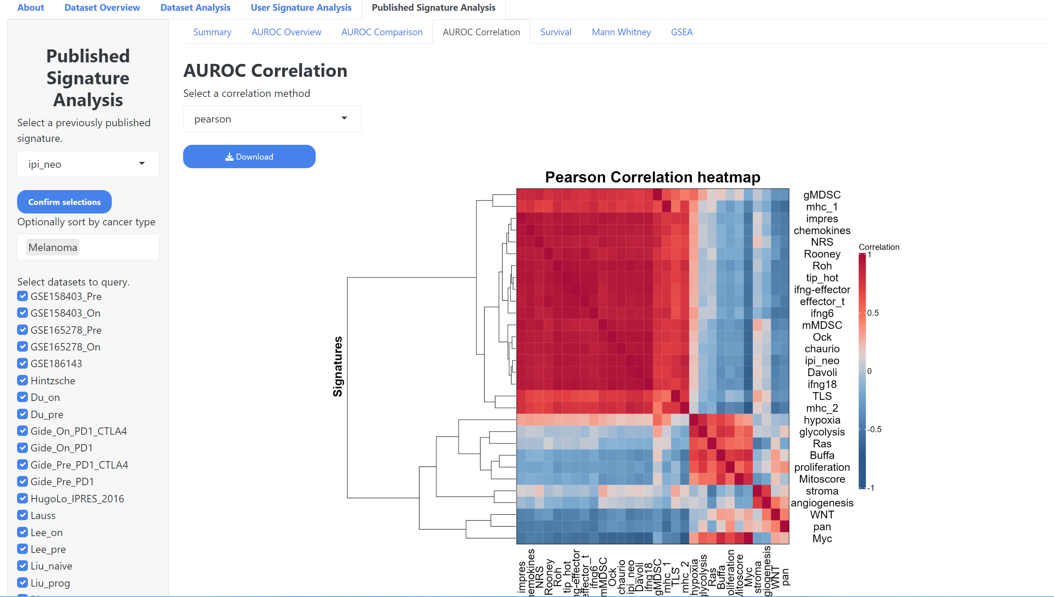
Previously Published Signatures – AUROC Correlation
Select a correlation method
Download correlation plot

Slide 32
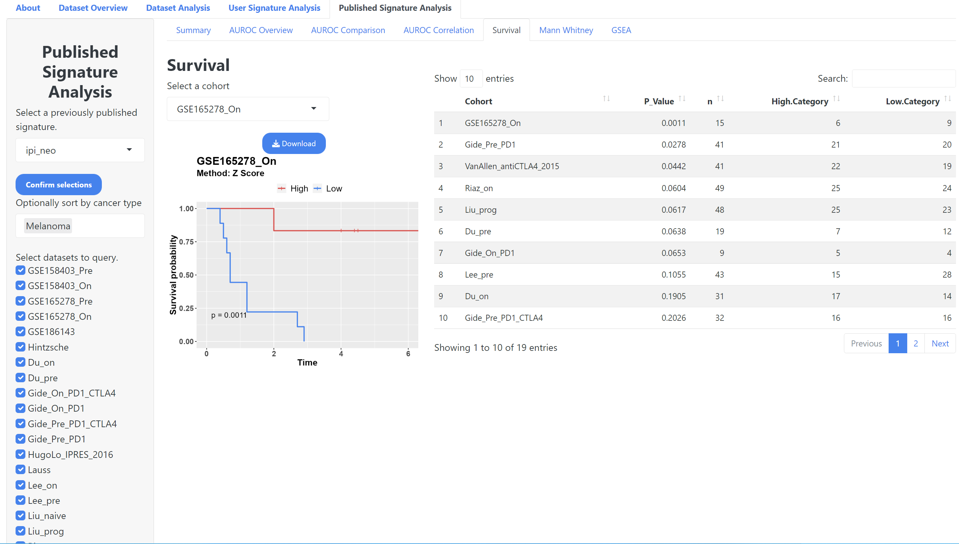
Previously Published Signature - Survival
Select a cohort to view
Download Survival Plot
Table showing p-value and other survival analysis stats

Slide 33
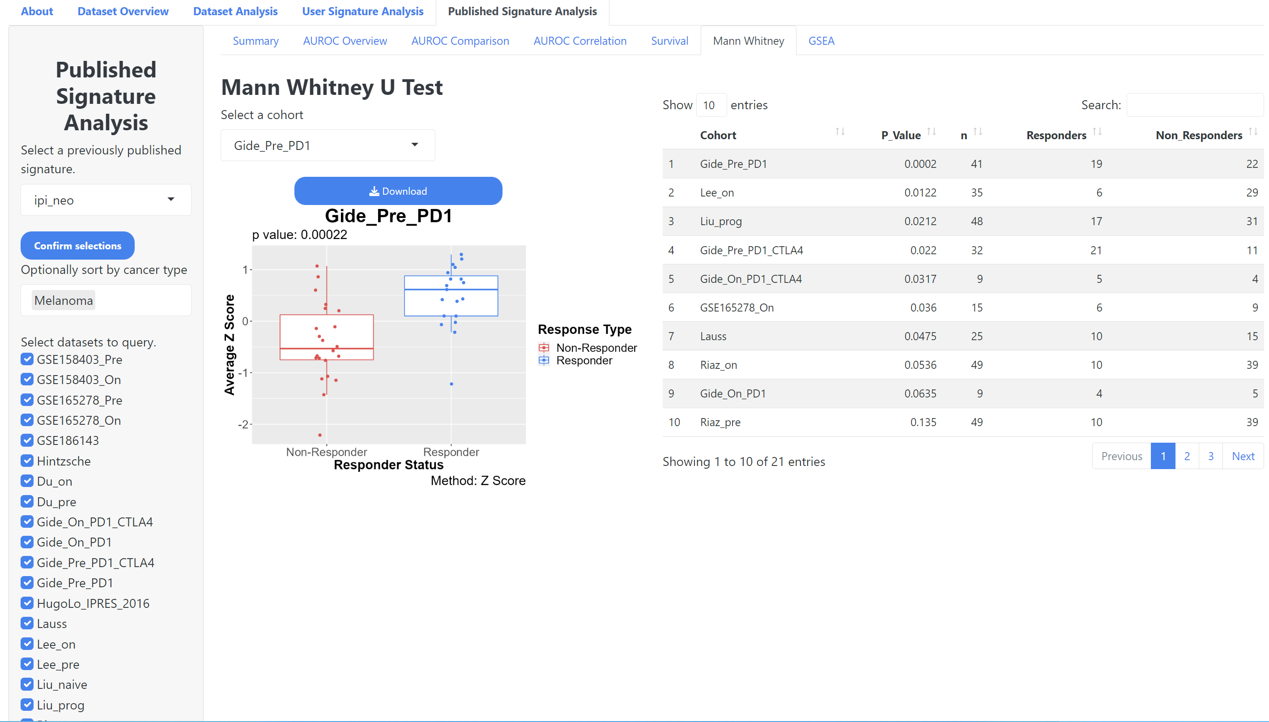
Previously Published Signature – Mann Whitney
Select a cohort to view
Download Plot
Data table containing Mann Whitney p-value and other statistics

Slide 34
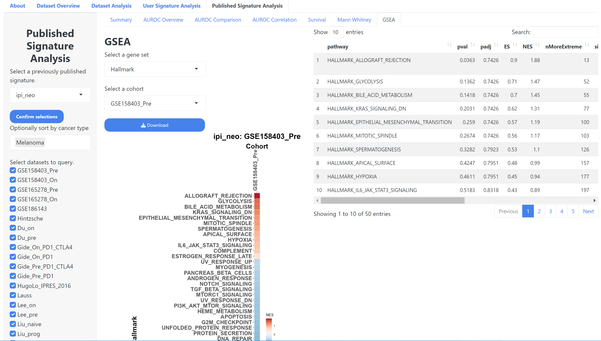
Previously Published Signature - GSEA
Select a gene set
Select a cohort
Download Plot
A data table showing the results of the GSEA analysis

